Slide 1
Grid reliability & resilience, baseload generation
& the DOE Staff Reliability Study
Alison Silverstein
PJM Energy Policy Roundtable
November 28, 2017

Slide 2
Definitions
Reliability has short- and long-term dimensions
  Short-term = operational security – withstand a sudden disturbance and still meet load without an uncontrolled cascading blackout or equipment damage. “Work the grid you’ve got”
  Long-term = resource adequacy -- ability to keep supply and demand in balance. Regulatory and compliance dimensions
Resiliency = the ability of a system to absorb, survive, restore and quickly recover from major (multi-hazard) adverse events.
Resiliency ≠ reliability

Slide 3
What’s the goal here?
What’s the problem we’re trying to solve?
Resiliency and reliability for generation is different from the grid is different from resiliency and reliability from customers’ perspective.
95+% of customer outages come from T&D failures, not from generation shortages or fuel shortages
We can buy a lot of T&D improvements and coal miner direct economic support for the $ billions it would cost to subsidize uneconomic coal and nuclear plants…

Slide 4
Coal, nuclear, reliability & resiliency
IF coal and nuclear plants are on-line, then they can help with:
Reliability
Frequency response (some)
Voltage control
Regulation (some)
Load-following (coal – some)
NOT SO MUCH – fast-cycling, fast-ramp, low minimum-load, contingency reserve
Resiliency
Fuel diversity
Fuel assurance (on-site)
NOT – black-start, distributed, or T&D-improving, and may be vulnerable to T&D, weather and climate problems

Slide 5
How to improve resiliency
Design for multiple hazards – earthquakes, ice storms, heat waves, lightning, blizzards, cyber attack, physical attack, EMP/GMD, …
Good preparation and resiliency practices (vegetation management, mutual aid, spares, restoration & recovery process plans & practice)
Better, diverse design and components
  Diverse assets
  Smart grid, sensors, automation, analytics
  Distributed assets (DG, DR, CHP, storage, renewables)
  Design system for graceful failure
  Energy efficiency for customer assets

Slide 6
Inertia
We need inertia for frequency response, not for its own sake.
  Rotating mass-based inertia (as from coal, nuclear, nat gas) works – but those plants not always on-line
  Electronically-coupled inertia (as from wind and solar) works within a narrow (planned) performance range
  Storage & DR can provide large, precise, fast primary and secondary frequency response at lower capital, ops and carbon costs than coal or nuclear

Slide 7
More to do on essential R&R services
Study the merits of and need for different types of frequency response (FR) provision and how much we actually need to manage a fast, modern grid
Identify, define metrics, productize & compensate FR and other essential reliability & resiliency services on a technology-neutral basis
Some essential R&R services can be requirements of grid interconnection & participation
Not all essential R&R services need to be market-competed

Slide 8
Past power plant retirements
(a reminder)

Slide 9
More definitions
Baseload generation – it’s an operational pattern (run with limited ramping for a long stretch), not a class of generators (coal, nuclear, natural gas steam).
Premature retirements – no such thing. Premature is in the eye of the beholder….

Slide 10
Causes of past coal & nuclear retirements
Root causes
Wholesale electric competition worked
Coal plants that retired were old and inefficient. Nuclear plants were higher-cost and “troubled”.
Other causes
Low natural gas prices starting 2009
Flattening demand for electricity starting 2008
Exacerbating factors BUT NOT CAUSES
Renewables are forcing more cycling & ramping
Environmental regulations raised costs on non-competitive plants, forcing retirement deadlines

Slide 11
Cause 1 – wholesale competition worked
Source: DOE Reliability Report 8/17
2002-2006: restructuring. Majority of retirements are smaller, older merchant plants
2007-2010: economic recession, shale gas, Mass v. EPA, strong utility-scale wind growth
2011-2015: sustained low electricity demand and NG prices, MATS deadline, CPP finalized
2016 on: nat gas & renewables replacing coal & nuclear, even for most coal & nuclear plant owners
Notes:
This and all subsequent graphics come from the DOE report or were prepared for it but not used.
Note early retirements in ERCOT and PJM, where wholesale and retail competition have been strong for the longest time.

Slide 12
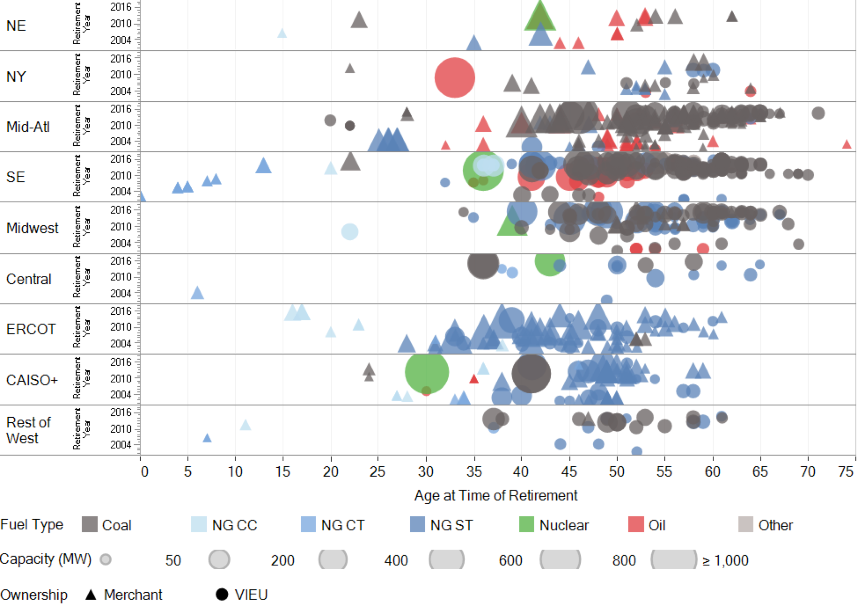
Cause 2 -- coal plants that retired were old
(THIS WAS NOT IN THE DOE REPORT…)
Source: DOE EIA, June 2017
Notes:
Note the age of retiring coal plants and NG steam plants – these were inefficient and poor competitors.
Also re the Mid-Atlantic and SE, the railroads haven’t bothered to lower coal transportation rates to protect coal traffic and keep delivered coal competitive…
Average age of remaining coal plants in early 2017 (after retirements) was 39 years. That’s the age where heat rate is lower and there are much higher costs to plant efficiency and remaining life due to cycling and ramping.

Slide 13
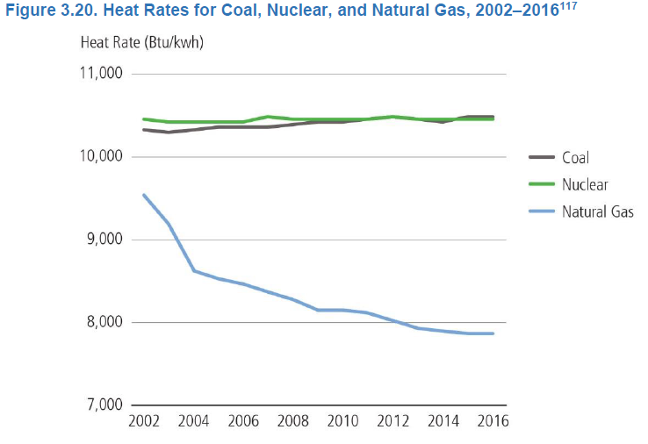
Cause 3 -- Coal and nukes can’t compete with natural gas
Low gas prices plus improved nat gas generator heat rates (30% over last 15 years). Coal heat rate declines with cycling and ramping.
Source: DOE Reliability Report 8/17

Slide 14
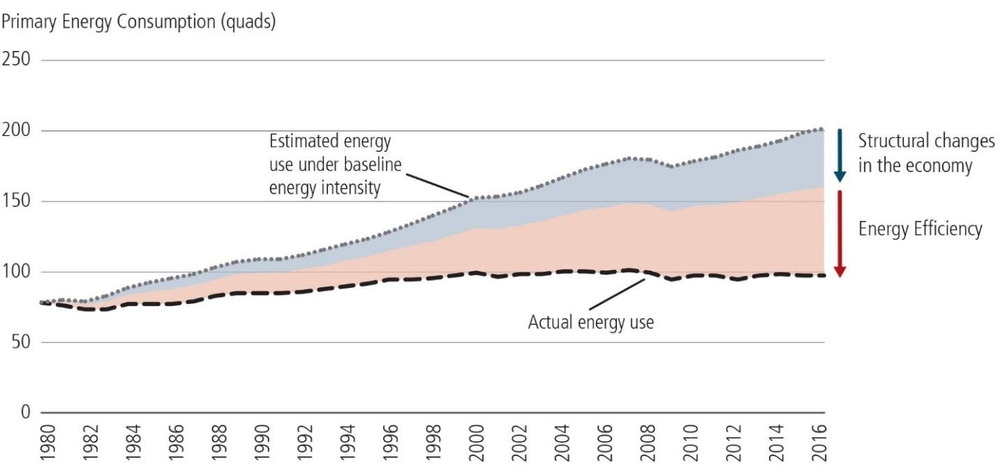
Cause 4 -- Flat demand changes things
Electricity demand growth flattened – increased at only 0.05% CAGR from 2005-2015 (even as GDP grew 1.3%/year). Flat demand hurts high-cost plants….
Figure 3.29. Gross Domestic Product and Net Electricity Production, Historical (1950–2016) and Projected (2017–2027)

Slide 15
Thank you
Alison Silverstein
alisonsilverstein@mac.com

